Slide 1


PLAKSHA INDUSTRIES PVT LTD
COMPANY PROFILE

Slide 2
PLAKSHA INDUSTRIES PVT. LTD.
COMPANY PROFILE

Slide 3
OUR VISION, MISSION AND VALUE
VISION:
To become a Global Healthcare Organization by providing Quality and affordable products to Society.
MISSION:
To work continuously to make cost effective Healthcare products so that they can become reachable to last person of society to make the right meaning of our tagline.
“Working towards Healthier Life”
VALUE:
Our Value are:
- Humanity
- Integrity
- Environment
- Passion
- Innovation

Slide 4
ABOUT US
Plaksha Industries Pvt. Ltd. established in Year-2020. It was the revolutionary venture in the area of Healthcare Sector. Our products are Finished Dosages i.e. tablets, Capsules, Syrups Ointments and Active pharmaceutical Ingredient, Intermediate and Key Raw Material.

Slide 5
FACILITY & SERVICES
Plaksha Manufacturing and supplying Active Pharma Ingredient, Intermediate and formulation products i.e. OSD , Syrup and Ointment.
Plaksha Industries had technical collaboration and support with 06 nos. pharmaceutical manufacturing plants in India which are dedicated to fulfill the requirement.
Our offered products are manufactured using optimum quality raw material with international Quality standards by a team of highly Qualified professionals. Further we make sure to make our products are available to the customer at leading prices in the market and within the stipulated time period.
Plaksha as a team is capable to fulfilling the bulk and urgent requirements of client in best possible time frame with Quality.
Plaksha Supply minimum and maximum quantity according to customer need /requirement.

Slide 6
PRODUCT PORT FOLIO FINISHED DOSAGES
Our extensive generics portfolio covers all the major therapeutic areas: these include medicinal products aimed for treatment of Infections, Analgesic, Drugs for treatment of anti-diabetics, Antibiotics, Anti-hypertensive anti-allergic and drug for treatment of the Gastro –Intestinal tract.

Slide 7
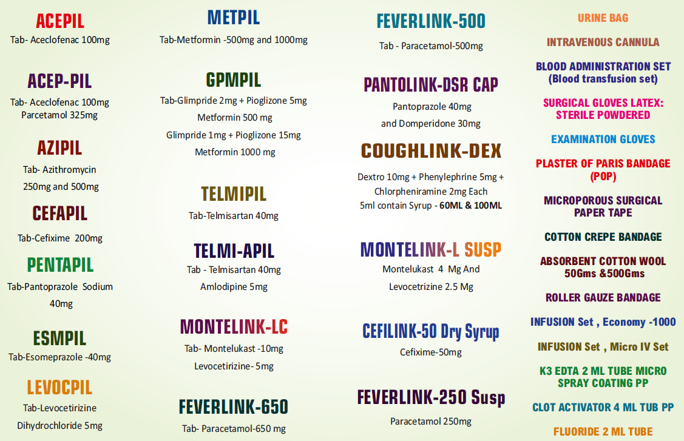
PRODUCT PORT FOLIO FINISHED DOSAGES

Slide 8
PRODUCT PORT FOLIO APIs ,KSM & INTERMEDIATES
Plaksha manufacturing and supplying Quality Active pharmaceutical Ingredients, Key starting materials for different API and Intermediates for different category / therapeutic drugs like Anti - malarial, Anti - Viral, Anti – Bacterial, Anti-diabetic, Anti-Hypertensive, Anticonvulsant, Anti – hyperuricemia, Anti – Fungal, Anti-asthma & allergic rhinitis, Anticoagulant, Anticonvulsants nerve pain etc.

Slide 9
PRODUCT PORT FOLIO APIs ,KSM & INTERMEDIATES
APIs:
Acyclovir
Vildagliptin
Febuxostat
Carbamazepine
Clotrimazole
Citicoline Sodium
Montelukast
Pregabalin
Apixaban
Intermediates:
ISBCC (Imino Stilbene Carbonyl Chloride)
CPCC (Cyclopropane carbonyl chloride)
Di Acetyl Guanine
Di Acetyl Acyclovir
DMACPH
2,3- Di-chlorobenzoyl Nitrile
L- Prolineamide
Chloro–Thiophene (2-Chlorothiophene)
DMBCC (Di methyl benzyl carbinyl acetate)
Specialty Chemicals:
Lauryl Chloride
N,N – Dimethyl Ethylene diamine
Para nitro Benzyl Alcohol

Slide 10
ABOUT FOUNDER DIRECTOR
Mrs. Aradhana Chauhan, Founder Director is well Qualified and have vast Experience in the field of Pharmaceutical Industry and Worked with Renowned company Lupin.
Mr. Yogendra Chauhan, Founder Director of the company is having more than 20+ years of Experience in Research & development and Operation management in Healthcare Sector and Worked with companies Like Ranbaxy , Lupin , Mylan and Unimark Remedies.

Slide 11
WHY US
Dynamic and Committed Professional Organization dedicated to customers.
Our products meets the National and International Quality Standards to ensure safe medical supplies.
Product manufactured under Strict WHO GMP Compliances.
Skilled Team of more than 25 Scientist with 2-25 years of Experience to Execute the task in Lab or in Plant.
We have full set-up of R&D Lab to deal with criticality of Products at earlier stage.
Plaksha believe to work to meet GMP Expectation and team is trend for the same goal.
Plaksha Offer a wide range of product portfolio and we believe in offering a single solution for all products
Our Collaborated manufacturing Units are currently manufacturing for ROW market.
We can manufacture according to the need of Buyer or according to the demand in market.

Slide 12
Thank you
Plaksha Industries Pvt. Ltd.
103, Shivam Industrial Park, Nr Parikh Packaging
Changodar, Ahmedabad, Gujarat – 382213 (INDIA)
yogendra@plakshaindustries.com
9879572661

